Slide 1

Product Sales Analysis
Presented by,
a.KavipriA, j.l.manovathi,
G.PRIYADHARSHINI,B.SWEATHA.

Slide 2
OBJECTIVES
1)APPLYING ML MODEL(REGULARIZATION)
2) SPLITTING THE TRAINING AND TESTING DATA
3)CREATING DASHBOARD USING IBM COGNOS
4)CREATING REPORT USING IBM COGNOS
5)STATISTICAL TESTS USING TREEMAP

Slide 3
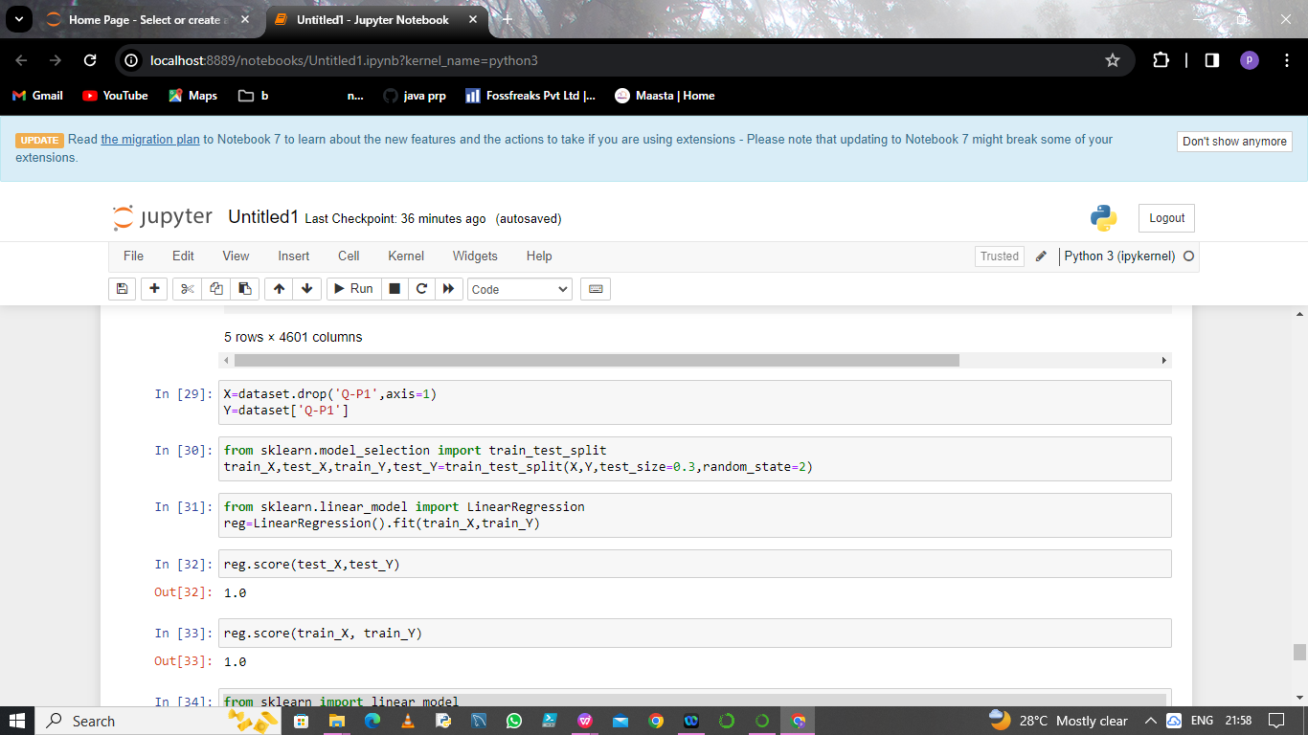
Step 1: Split the dataset into test data and train data

Slide 4
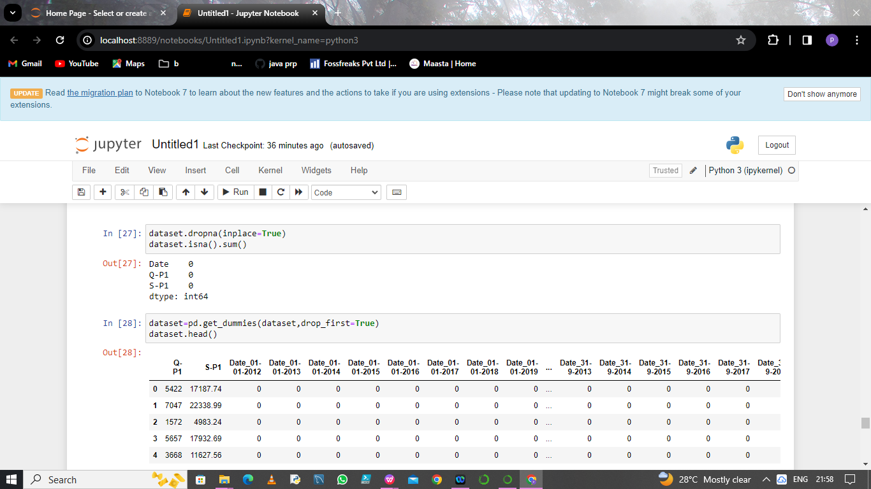
Step 2:Applying the regularization model to the dataset

Slide 5
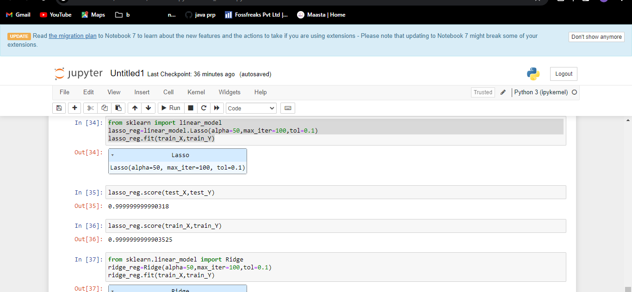
Step 3:Calculating the loss value

Slide 6
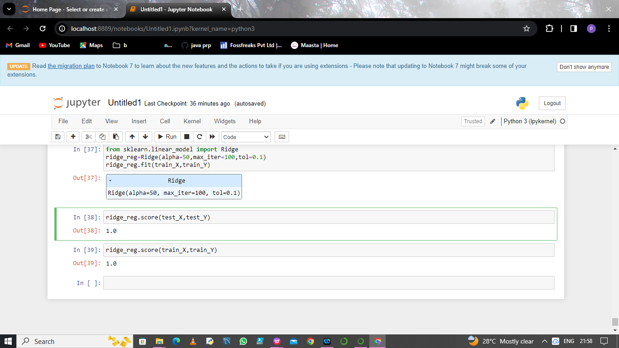
step:4 calculate the accuracy

Slide 7
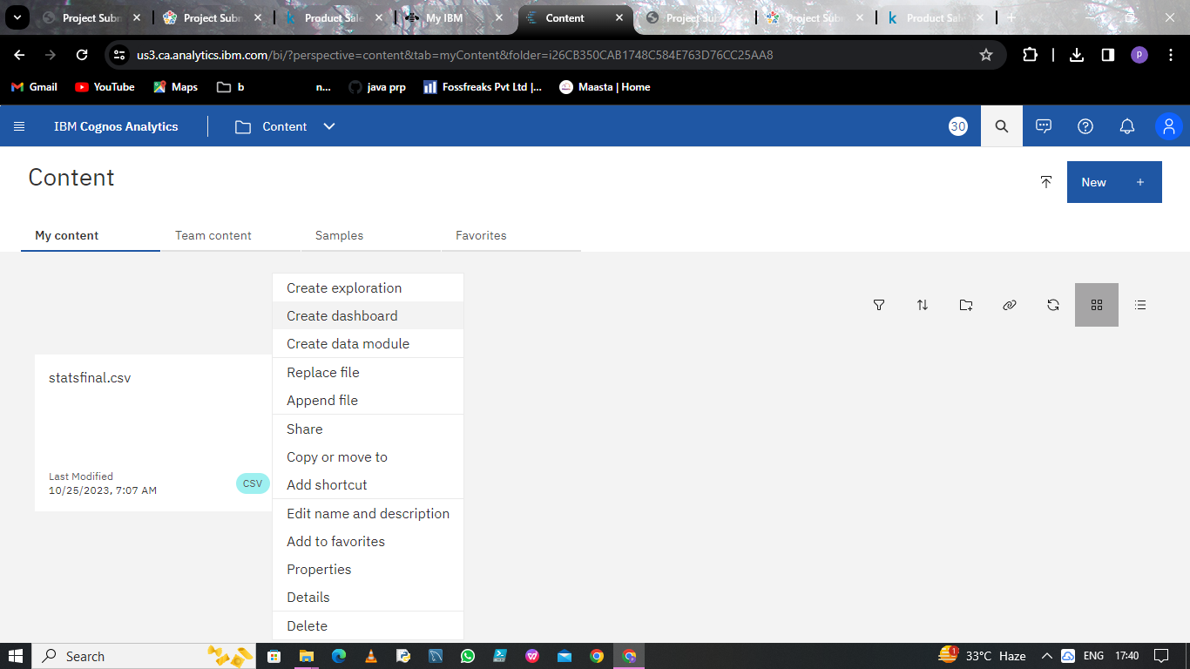
Step 5: CREATING DASHBOARD USING IBM COGNOS

Slide 8
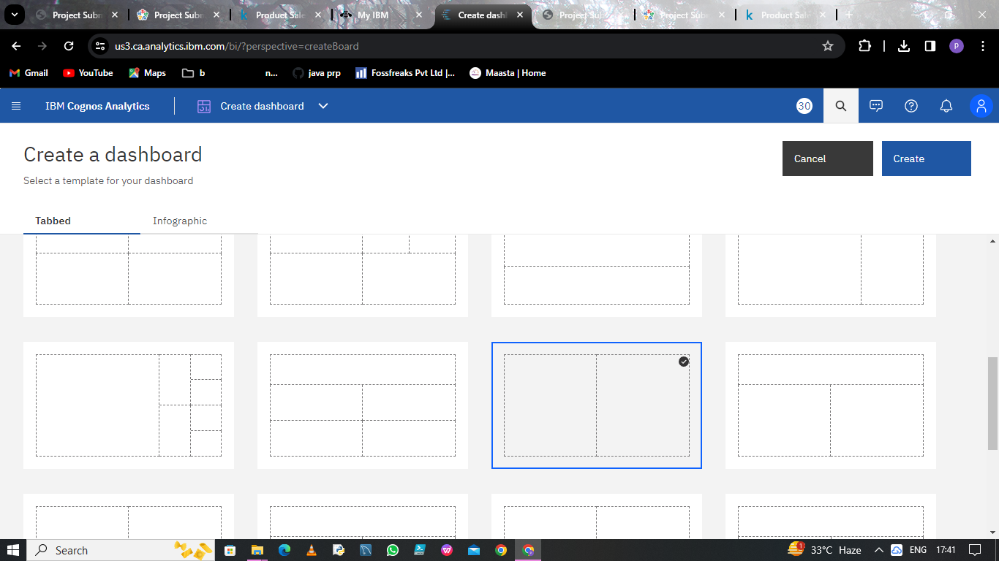

Slide 9
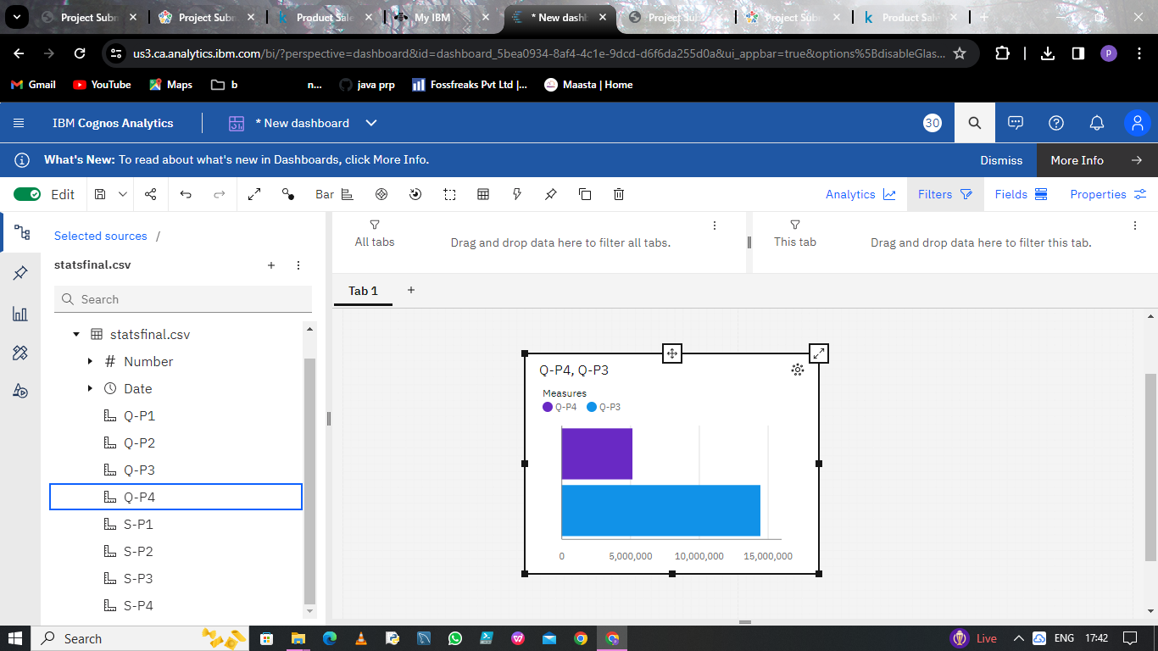

Slide 10
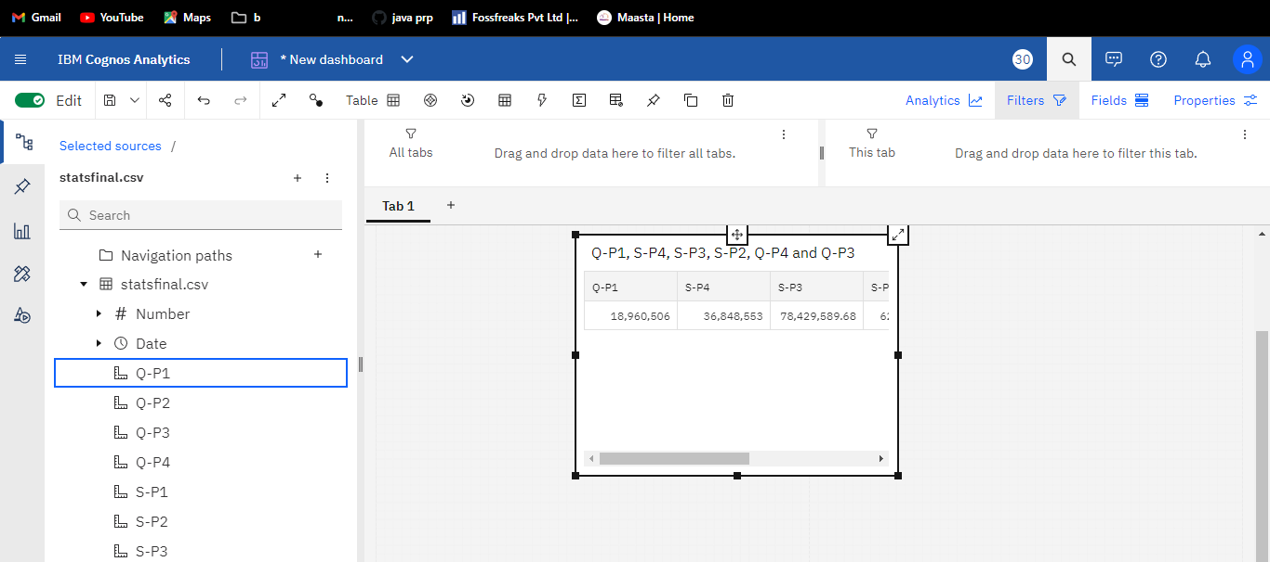

Slide 11
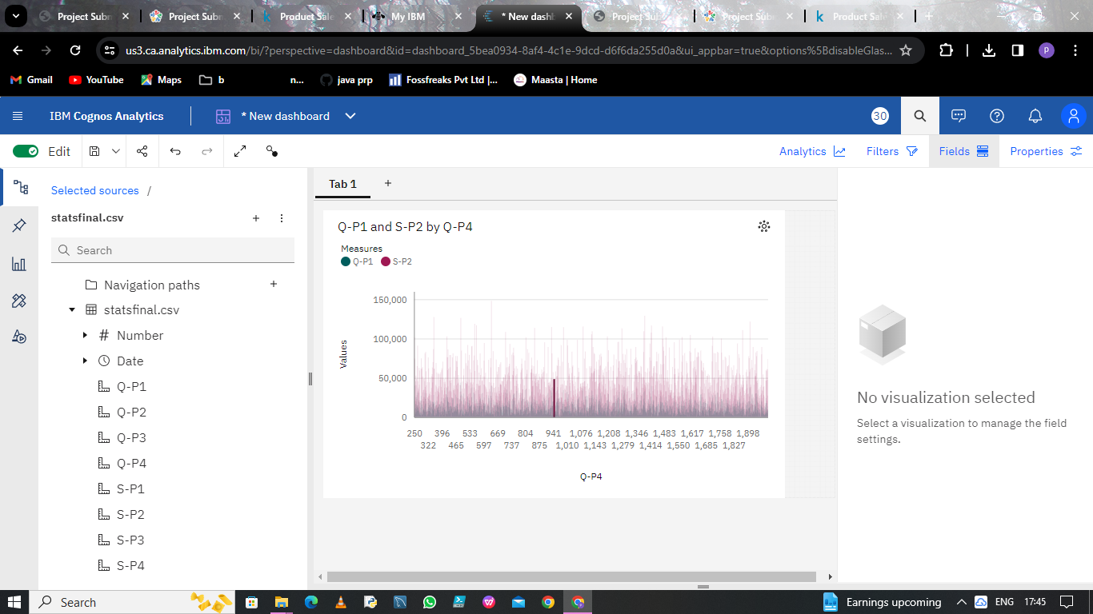
Creating bar graph using dashboard

Slide 12
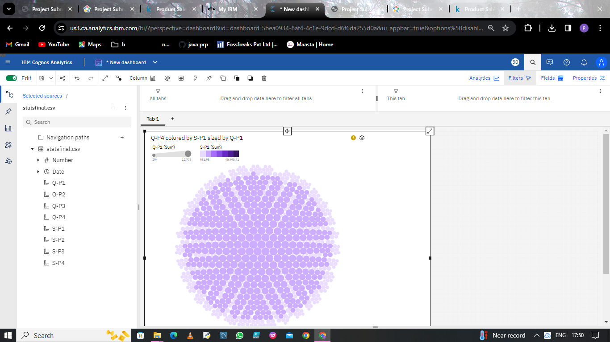
Creating packed ball structure using dashboard

Slide 13
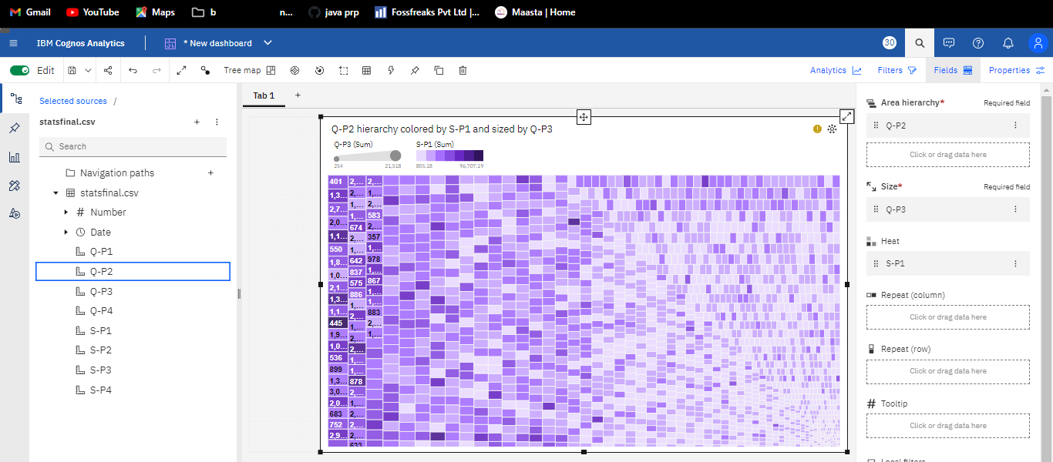
Creating area using dashboard

Slide 14
Step 4: CREATING REPORT USING IBM COGNOS

Slide 15
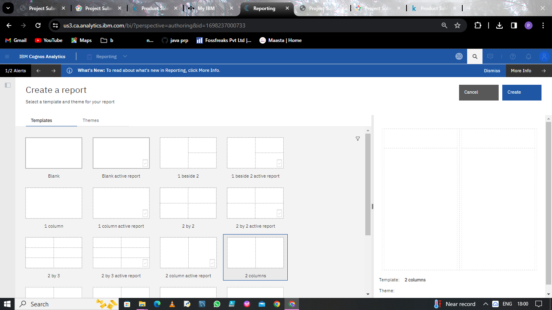

Slide 16
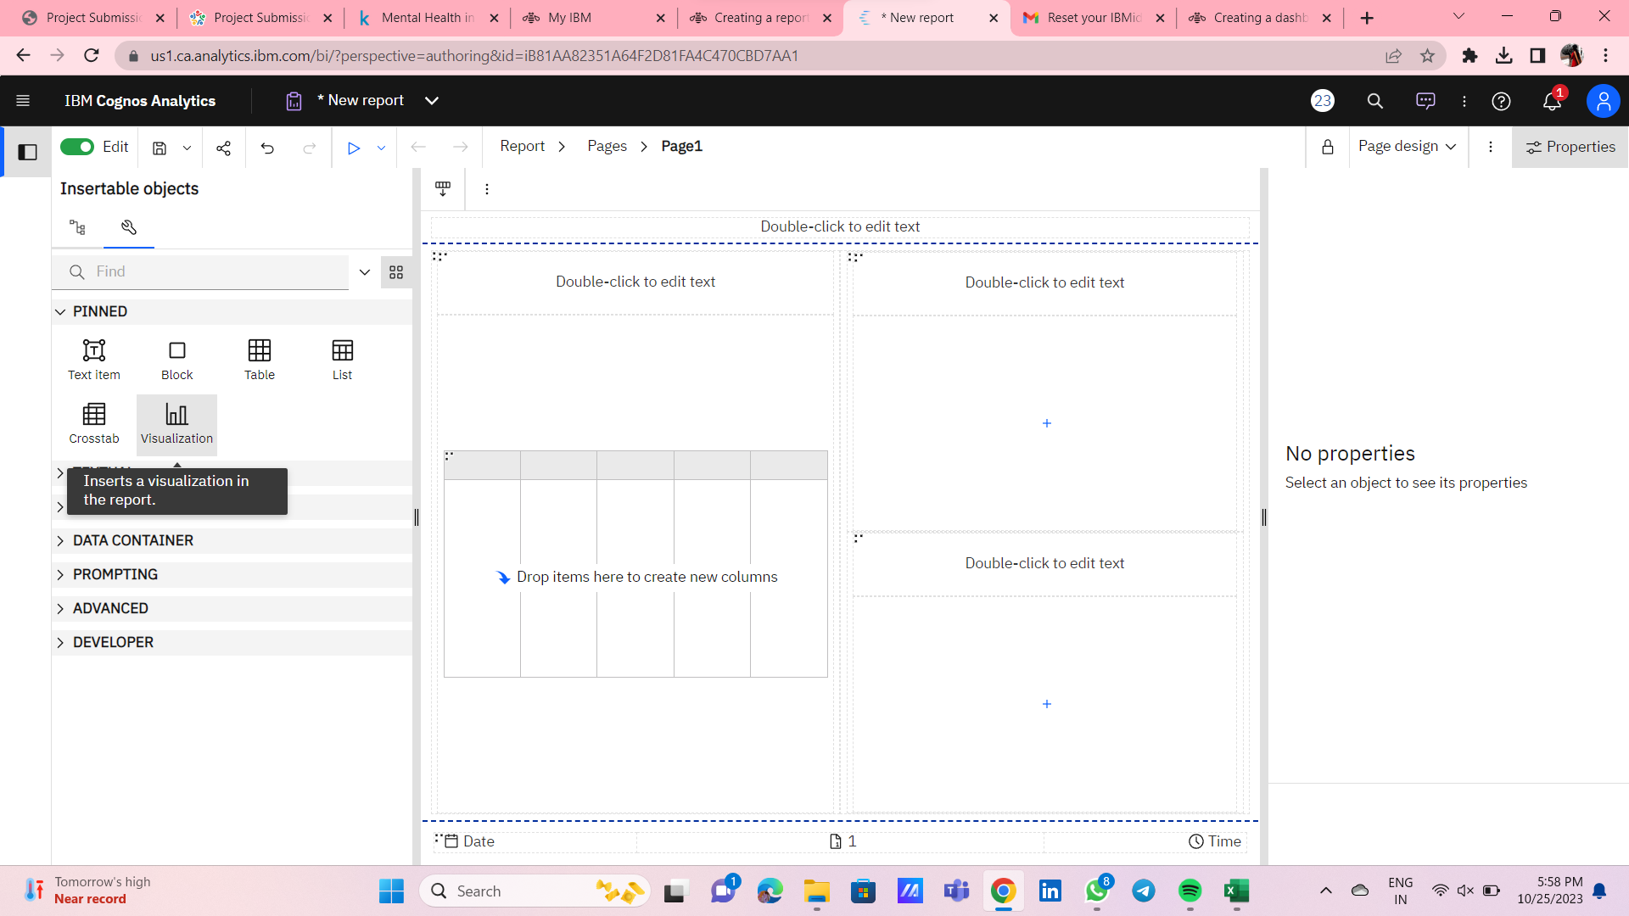

Slide 17
Creating bar graph using report

Slide 18
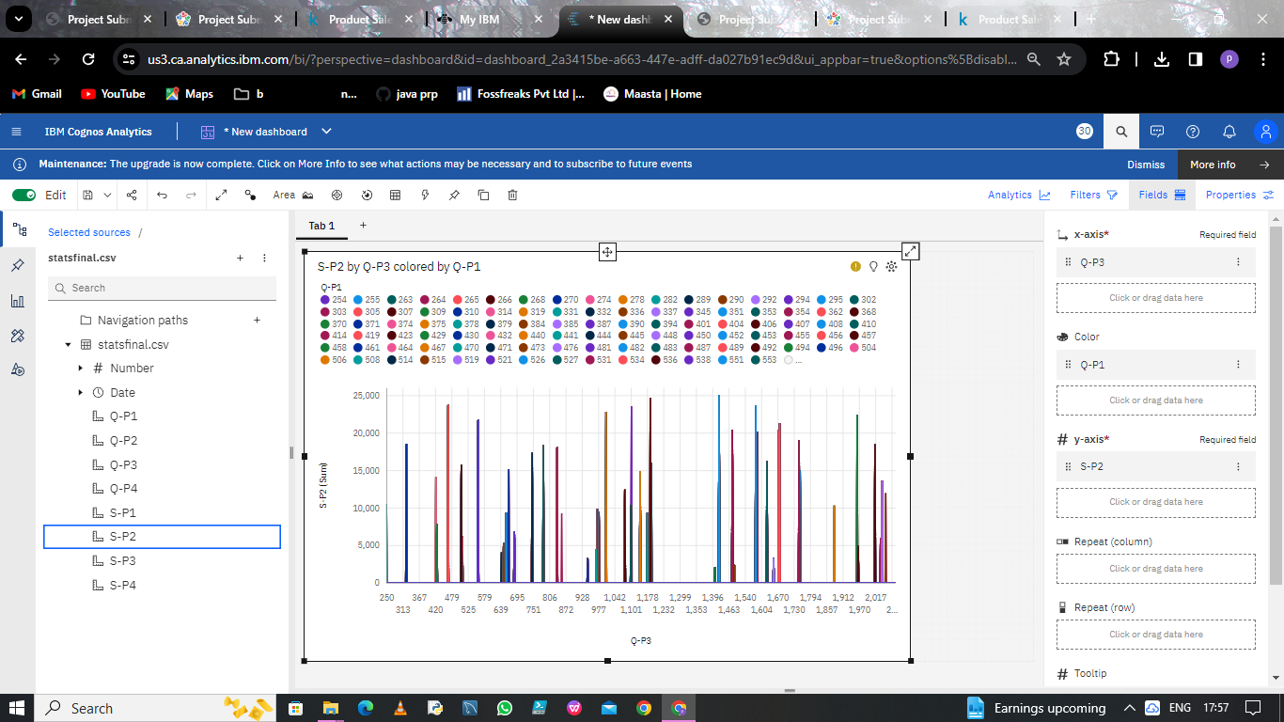
Step 5: STATISTICAL TESTS USING TREEMAP

Slide 19
THANK YOU

